Slide 1
CS 425 / ECE 428
Distributed Systems
Fall 2014
Indranil Gupta (Indy)
Lecture 22: Stream Processing, Graph Processing
All slides © IG

Slide 2
Stream Processing: What We’ll Cover
Why Stream Processing
Storm

Slide 3
Stream Processing Challenge
Large amounts of data => Need for real-time views of data
  Social network trends, e.g., Twitter real-time search
  Website statistics, e.g., Google Analytics
  Intrusion detection systems, e.g., in most datacenters
Process large amounts of data
  With latencies of few seconds
  With high throughput

Slide 4
MapReduce?
Batch Processing => Need to wait for entire computation on large dataset to complete
Not intended for long-running stream-processing

Slide 5
Enter Storm
Apache Project
https://storm.incubator.apache.org/
Highly active JVM project
Multiple languages supported via API
  Python, Ruby, etc.
Used by over 30 companies including
  Twitter: For personalization, search
  Flipboard: For generating custom feeds
  Weather Channel, WebMD, etc.

Slide 6
Storm Components
Tuples
Streams
Spouts
Bolts
Topologies

Slide 7
Tuple
An ordered list of elements
E.g., <tweeter, tweet>
  E.g., <“Miley Cyrus”, “Hey! Here’s my new song!”>
  E.g., <“Justin Bieber”, “Hey! Here’s MY new song!”>
E.g., <URL, clicker-IP, date, time>
  E.g., <coursera.org, 101.201.301.401, 4/4/2014, 10:35:40>
  E.g., <coursera.org, 901.801.701.601, 4/4/2014, 10:35:42>
Tuple

Slide 8
Stream
Sequence of tuples
  Potentially unbounded in number of tuples
Social network example:
  <“Miley Cyrus”, “Hey! Here’s my new song!”>,
  <“Justin Bieber”, “Hey! Here’s MY new song!”>,
  <“Rolling Stones”, “Hey! Here’s my old song that’s still a super-hit!”>, …
Website example:
  <coursera.org, 101.201.301.401, 4/4/2014, 10:35:40>, <coursera.org, 901.801.701.601, 4/4/2014, 10:35:42>, …
Tuple
Tuple
Tuple

Slide 9

Spout
A Storm entity (process) that is a source of streams
Often reads from a crawler or DB
Tuple
Tuple
Tuple
Tuple
Tuple
Tuple

Slide 10
Bolt
A Storm entity (process) that
  Processes input streams
  Outputs more streams for other bolts

Slide 11
Topology
A directed graph of spouts and bolts (and output bolts)
Corresponds to a Storm “application”

Slide 12
Topology
Can have cycles if the application
requires it

Slide 13
Bolts come in many Flavors
Operations that can be performed
  Filter: forward only tuples which satisfy a condition
  Joins: When receiving two streams A and B, output all pairs (A,B) which satisfy a condition
  Apply/transform: Modify each tuple according to a function
  And many others
But bolts need to process a lot of data
  Need to make them fast

Slide 14
Parallelizing Bolts
Have multiple processes (“tasks”) constitute a bolt
Incoming streams split among the tasks
Typically each incoming tuple goes to one task in the bolt
  Decided by “Grouping strategy”
Three types of grouping are popular

Slide 15
Grouping
Shuffle Grouping
  Streams are distributed randomly to the bolt’s tasks
  Randomly but consistently – use a hash function! (Remember consistent hashing from P2P systems?)
Fields Grouping
  Group a stream by a subset of its fields
  E.g., All tweets where twitter username starts with [A-M,a-m,0-4] goes to task 1, and all tweets starting with [N-Z,n-z,5-9] go to task 2
All Grouping
  All tasks of bolt receive all input tuples
  Useful for joins

Slide 16
Storm Cluster
Master node
  Runs a daemon called Nimbus
  Responsible for
    Distributing code around cluster
    Assigning tasks to machines
    Monitoring for failures of machines
Worker node
  Runs on a machine (server)
  Runs a daemon called Supervisor
  Listens for work assigned to its machines
Zookeeper
  Coordinates Nimbus and Supervisors communication
  All state of Supervisor and Nimbus is kept here

Slide 17
Failures
A tuple is considered failed when its topology (graph) of resulting tuples fails to be fully processed within a specified timeout
Anchoring: Anchor an output to one or more input tuples
  Failure of one tuple causes one or more tuples to replayed

Slide 18
API For Fault-Tolerance (OutputCollector)
Emit(tuple, output)
  Emits an output tuple, perhaps anchored on an input tuple (first argument)
Ack(tuple)
  Acknowledge that you (bolt) finished processing a tuple
Fail(tuple)
  Immediately fail the spout tuple at the root of tuple topology if there is an exception from the database, etc.
Must remember to ack/fail each tuple
  Each tuple consumes memory. Failure to do so results in memory leaks.

Slide 19
Summary: Stream Processing
Processing data in real-time a big requirement today
Storm
  And other sister systems, e.g., Spark Streaming
Parallelism
Application topologies
Fault-tolerance

Slide 20
Graph Processing: What We’ll Cover
Distributed Graph Processing
Google’s Pregel system
  Inspiration for many newer graph processing systems: Piccolo, Giraph, GraphLab, PowerGraph, LFGraph, X-Stream, etc.

Slide 21
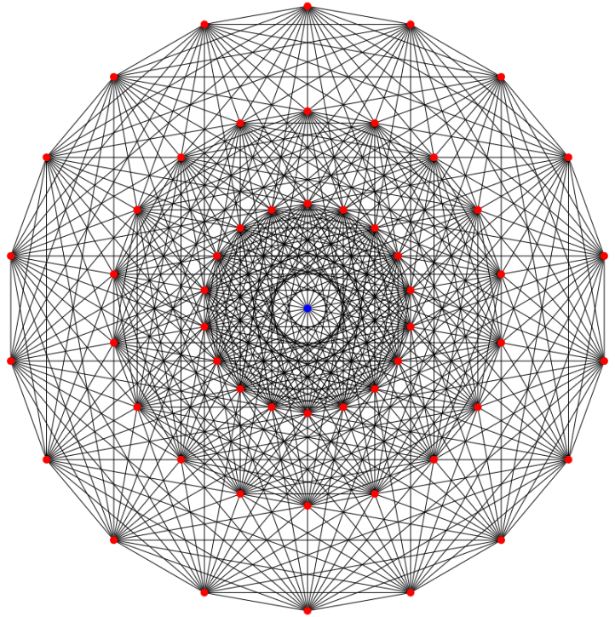
Lots of Graphs
Large graphs are all around us
  Internet Graph: vertices are routers/switches and edges are links
  World Wide Web: vertices are webpages, and edges are URL links on a webpage pointing to another webpage
    Called “Directed” graph as edges are uni-directional
  Social graphs: Facebook, Twitter, LinkedIn
  Biological graphs: DNA interaction graphs, ecosystem graphs, etc.
Source: Wikimedia Commons

Slide 22
Graph Processing Operations
Need to derive properties from these graphs
Need to summarize these graphs into statistics
E.g., find shortest paths between pairs of vertices
  Internet (for routing)
  LinkedIn (degrees of separation)
E.g., do matching
  Dating graphs in match.com (for better dates)
PageRank
  Web Graphs
  Google search, Bing search, Yahoo search: all rely on this
And many (many) other examples!

Slide 23
Why Hard?
Because these graphs are large!
  Human social network has 100s Millions of vertices and Billions of edges
  WWW has Millions of vertices and edges
Hard to store the entire graph on one server and process it
  Slow on one server (even if beefy!)
Use distributed cluster/cloud!

Slide 24
Typical Graph Processing Application
Works in iterations
Each vertex assigned a value
In each iteration, each vertex:
  Gathers values from its immediate neighbors (vertices who join it directly with an edge). E.g., @A: B→A, C→A, D→A,…
  Does some computation using its own value and its neighbors values.
  Updates its new value and sends it out to its neighboring vertices. E.g., A→B, C, D, E
Graph processing terminates after: i) fixed iterations, or ii) vertices stop changing values
C
B
A
D
E

Slide 25
Hadoop/MapReduce to the Rescue?
Multi-stage Hadoop
Each stage == 1 graph iteration
Assign vertex ids as keys in the reduce phase
Well-known
At the end of every stage, transfer all vertices over network (to neighbor vertices)
  All vertex values written to HDFS (file system)
  Very slow!

Slide 26
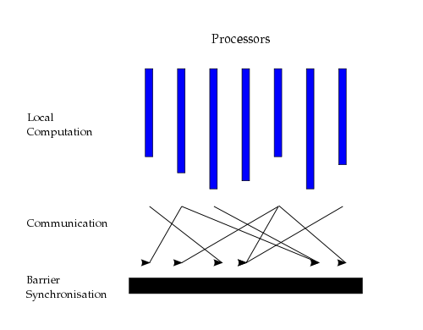
Bulk Synchronous Parallel Model
“Think like a vertex”
Originally by Valiant (1990)
Source: http://en.wikipedia.org/wiki/Bulk_synchronous_parallel

Slide 27
Basic Distributed Graph Processing
“Think like a vertex”
Assign each vertex to one server
Each server thus gets a subset of vertices
In each iteration, each server performs Gather-Apply-Scatter for all its assigned vertices
  Gather: get all neighboring vertices’ values
  Apply: compute own new value from own old value and gathered neighbors’ values
  Scatter: send own new value to neighboring vertices

Slide 28
Assigning Vertices
How to decide which server a given vertex is assigned to?
Different options
  Hash-based: Hash(vertex id) modulo number of servers
    Remember consistent hashing from P2P systems?!
  Locality-based: Assign vertices with more neighbors to the same server as its neighbors
    Reduces server to server communication volume after each iteration
    Need to be careful: some “intelligent” locality-based schemes may take up a lot of upfront time and may not give sufficient benefits!

Slide 29
Pregel System By Google
Pregel uses the master/worker model
  Master (one server)
    Maintains list of worker servers
    Monitors workers; restarts them on failure
    Provides Web-UI monitoring tool of job progress
  Worker (rest of the servers)
    Processes its vertices
    Communicates with the other workers
Persistent data is stored as files on a distributed storage system (such as GFS or BigTable)
Temporary data is stored on local disk

Slide 30
Pregel Execution
Many copies of the program begin executing on a cluster
The master assigns a partition of input (vertices) to each worker
  Each worker loads the vertices and marks them as active
The master instructs each worker to perform a iteration
  Each worker loops through its active vertices & computes for each vertex
  Messages can be sent whenever, but need to be delivered before the end of the iteration (i.e., the barrier)
  When all workers reach iteration barrier, master starts next iteration
Computation halts when, in some iteration: no vertices are active and when no messages are in transit
Master instructs each worker to save its portion of the graph

Slide 31
Fault-Tolerance in Pregel
Checkpointing
  Periodically, master instructs the workers to save state of their partitions to persistent storage
    e.g., Vertex values, edge values, incoming messages
Failure detection
  Using periodic “ping” messages from master → worker
Recovery
  The master reassigns graph partitions to the currently available workers
  The workers all reload their partition state from most recent available checkpoint

Slide 32
How Fast Is It?
Shortest paths from one vertex to all vertices
  SSSP: “Single Source Shortest Path”
On 1 Billion vertex graph (tree)
  50 workers: 180 seconds
  800 workers: 20 seconds
50 B vertices on 800 workers: 700 seconds (~12 minutes)
Pretty Fast!

Slide 33
Summary: Graph Processing
Lots of (large) graphs around us
Need to process these
MapReduce not a good match
Distributed Graph Processing systems: Pregel by Google
Many follow-up systems
  Piccolo, Giraph: Pregel-like
  GraphLab, PowerGraph, LFGraph, X-Stream: more advanced

